Slide 1


FULL STACK WEB DEVELOPMENT WITH DJANGO
Lecture 11

Slide 2

Today’s Agenda
Developing Our Django App
Passing Data To Templates
Concept Of Template Variable
Example

Slide 3
Passing Data To Templates
We can also pass values to our template using the concept of template variables.
These template variables will allow us to inject content into the HTML directly from Views.
And later we can use Python code to inject content from a database!

Slide 4
Passing Data To Templates
Syntax:
A variable looks like this: {{variable}}.
The template replaces the {{variable}} by the actual variable’s value sent by the view in the third parameter ( called context ) of the render() function.
The only point to remember is that this variable has to be passed as a key-value pair from view because templates receive these variables inside a dictionary.

Slide 5
Example
Suppose this is our HTML file called hello.html
<html>
<body>
Hello World!!!<br>
Good Morning From {{ name }}
</body>
</html>
Now our view will change to −
def hello(request):
myname= "Sachin"
return render(request, "hello.html", {"name" : myname})
The output we will get is:
Hello World!!!
Good Morning From Sachin

Slide 6

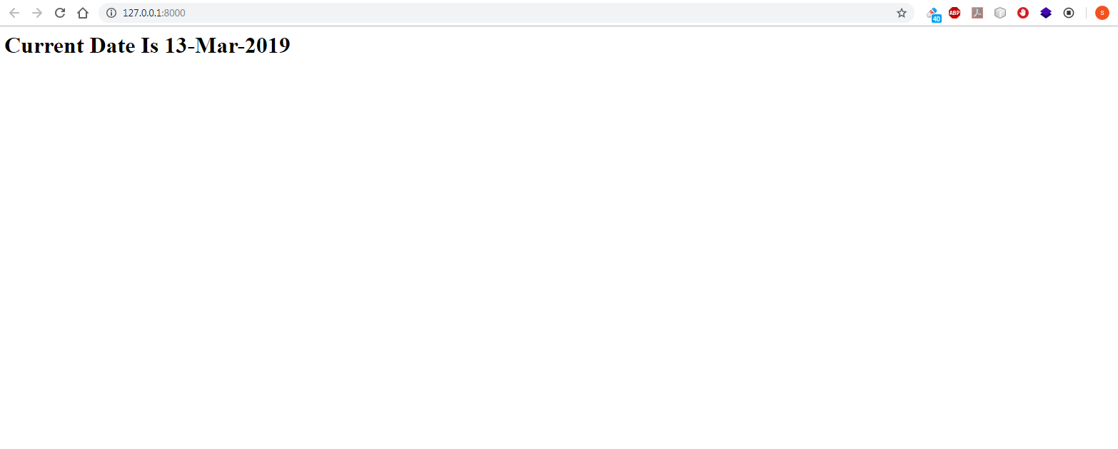
Exercise
Write a Django App using templates which displays current date as the user opens the home page
Output:

Slide 7
Solution
As usual we will first have to setup VS Code and create the project and app as follows:
Open VS Code and open the folder myvsdjangoproject in it
Open the command palette and new terminal to activate django virtual environment
Now create a project called demoproject7 using the usual command django-admin startproject demoproject7
Then create the app by using the command
django-admin startapp dynamictemplateapp
Create a folder called templates in the root folder demoproject7 and within templates create a folder called dynamictemplateapp

Slide 8
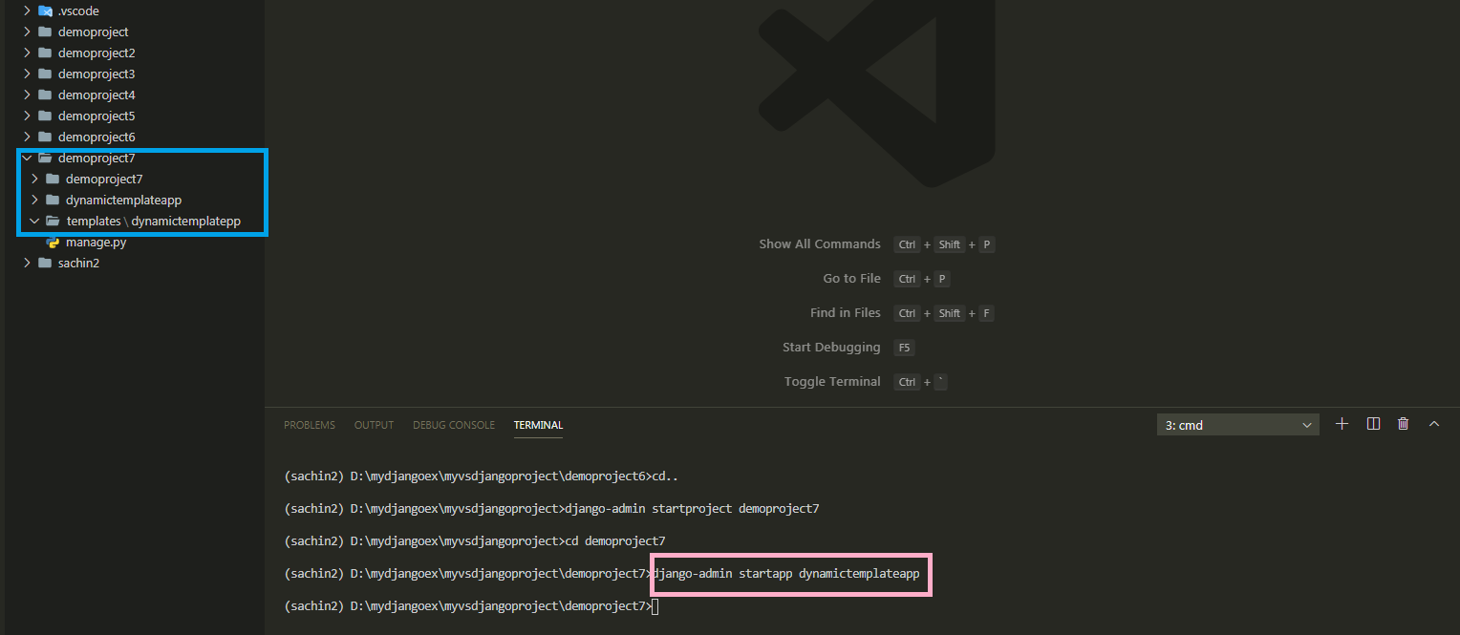
Solution

Slide 9
Solution
After doing all the initial setup in VS Code , the next task is to update the settings.py file by making 2 entries:
Entry for the app in the INSTALLED APPS list
Entry for the template directory in DIR key of TEMPLATES

Slide 10
Solution
Open the settings.py file in the demoproject7 app of our demoproject7 folder and make the entry shown in green color in the INSTALLED_APPS list
Code:
INSTALLED_APPS = [
'django.contrib.admin',
'django.contrib.auth',
'django.contrib.contenttypes',
'django.contrib.sessions',
'django.contrib.messages',
'django.contrib.staticfiles',
‘dynamictemplateapp',
]

Slide 11
Solution
As discussed previously , after creating templates folder we must inform Django about it.
To do this we must follow the following steps:
Open the settings.py file in the demoproject7 app
Write the code shown in green color
TEMPLATES_DIR=os.path.join(BASE_DIR, 'templates')
TEMPLATES = [
{ ...
'DIRS': [TEMPLATES_DIR],
... },
]

Slide 12
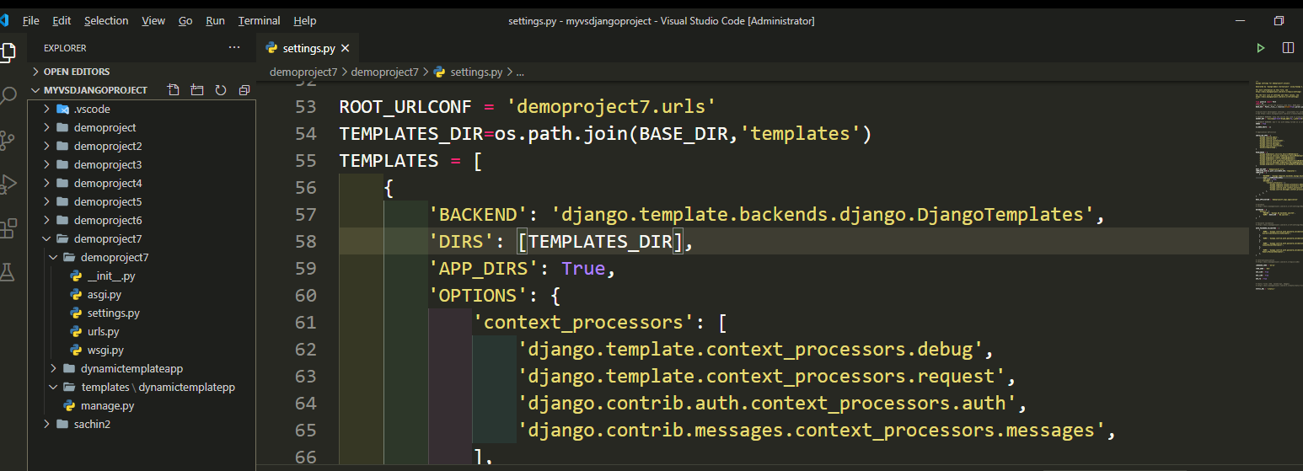
Solution

Slide 13
Solution
Once we’ve done creating templates folder structure then we can create an html file called showdate.html inside of the templates/dynamictemplateapp directory.
This file should contain a template variable called today

Slide 14
Solution
#showdate.html
<!DOCTYPE html>
<html lang="en">
<head>
<meta charset="UTF-8">
<meta name="viewport" content="width=device-width, initial-scale=1.0">
<meta http-equiv="X-UA-Compatible" content="ie=edge">
<title>Template Variable Demo</title>
</head>
<body>
<h2>Current Date Is {{today}} </h2>
</body>
</html>

Slide 15
Solution
Now we have the template in place, we need to update our views.py.
In our views.py file , we must create a datetime object and extract current date from it .
Then we should call the render() function passing it 3 arguments:
Request object
Template file path
String representing current date
Make sure that we pass the third argument as a dictionary with the key as ‘today’ and it’s value as current date

Slide 16
Solution
from django.shortcuts import render
from datetime import datetime
def showDate(request):
currDate = datetime.now()
my_dict = {'today': currDate.strftime("%d-%b-%Y")}
return render(request,'dynamictemplateapp/showdate.html',my_dict)

Slide 17
Solution
After creating and updating the views.py we need to tell Django this is the view we want displayed when someone navigates to the site root (home page).
As usual we do this by configuring our URLs at 2 places:
Inside the dynamictemplateapp directory’s urls.py file
Inside the site’s main urls.py

Slide 18
Solution
In the VS Code create a new file called urls.py in the dynamictemplateapp folder and write the following code in it.
Code (dynamictemplateapp/urls.py):
from django.urls import path
from . import views
urlpatterns = [
path('', views.showDate),
]

Slide 19
Solution
As we know whenever a request arrives it first hits the main urls.py file , that is , the file urls.py in the directory demoproject7
So we must configure this file also so that it simply redirects the request to our dynamictemplateapp’s urls.py file whenever a request arrives

Slide 20
Solution
In the VS Code open the file called urls.py in the demoproject7 folder and update the code in it as shown below in green.
Code (demoproject7/urls.py):
from django.contrib import admin
from django.urls import path,include
urlpatterns = [
path('admin/', admin.site.urls),
path('',include('dynamictemplateapp.urls'))
]

Slide 21
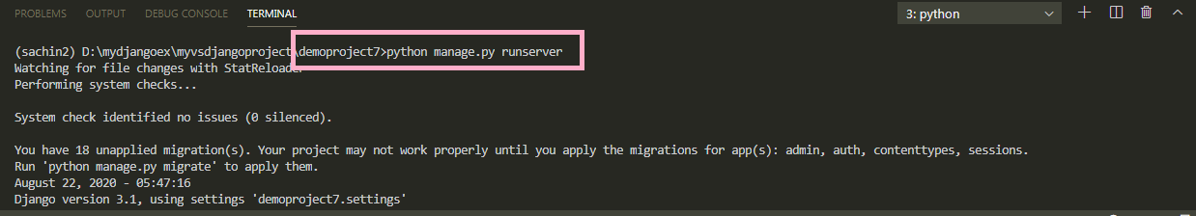
Solution
To run our new dynamictemplateapp2, go to the folder demoproject7by using cd command and type the runserver command in VS Code terminal
cd demoproject7
python manage.py runserver.
The server runs on the default port 8000, and we’ll see output like the following output in the terminal window:

Slide 22
Solution
Ctrl+click the http://127.0.0.1:8000/ URL in the terminal output window to
open default browser to that address. Now we should see the current date as a
template based home page

Slide 23
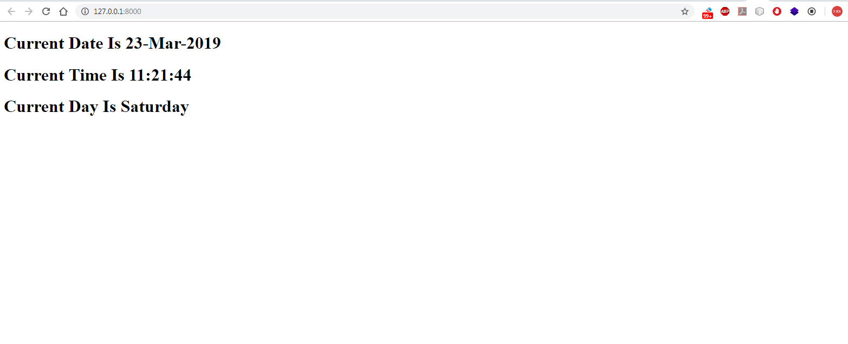
Exercise
Modify the previous exercise , so that now your page displays three information Current Date , Current Time and Current Day.
Output:

Slide 24
Solution
Everything will remain same except 2 changes
We will have to update the view so that it now sends three values to the template
In the HTML file we will have to use three template variable tags to retrieve the values sent by the view

Slide 25
Solution (views.py)
from django.shortcuts import render
from datetime import *
def homePageView(request):
curr_date=datetime.now()
curr_date_str=curr_date.strftime("%d-%b-%Y")
curr_time_str=curr_date.strftime("%H:%M:%S")
curr_day_str=curr_date.strftime("%A")
my_dict={'cdate':curr_date_str,'ctime':curr_time_str,'day':curr_day_str}
return render(request,"templateapp2/showdate.html",my_dict)

Slide 26
Solution(showdate.html)
<!DOCTYPE html>
<html lang="en">
<head>
<meta charset="UTF-8">
<meta name="viewport" content="width=device-width, initial-scale=1.0">
<meta http-equiv="X-UA-Compatible" content="ie=edge">
<title>Template Variable Demo</title>
</head>
<body>
<h1>Current Date Is {{cdate}} </h1>
<h1>Current Time Is {{ctime}} </h1>
<h1>Current Day Is {{cday}} </h1>
</body>
</html>

